Slide 1

HEART BEAT SENSOR

Slide 2
INTRODUCTION
The heart beat monitoring system using GSM technology is used for periodic monitoring of patients those who are suffering from heart disease (cardiac disease)
The heart beat sensor named pulse oximeter is interfaced with GSM modem to send the heartrate to the user interfaced with the system
Control action is taken by Arduino & communication is taken by GSM with the help of UART

Slide 3
THRESHOLD VALUE
Normal range of BPM is 60-80 BPM
If heart beat <40 times a minute, BRADYCARDIA occurs leads to short of breath.
If heart beat>100 times a minute, TACHYCARDIA occurs leads to heart failure, stroke or sudden cardiac death

Slide 4
FLOW CHART
SENSOR
The heart beat is sensed by heart beat sensor and given to the arduino through op-amp
ARDUINO
Loaded with the corresponding program and interface with the GSM
GSM
SIM is inserted to the GSM and 12v 1A power supply is given to the GSM
PHONE
Call or message received by a relative mobile

Slide 5
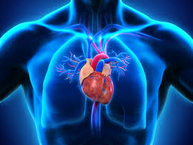
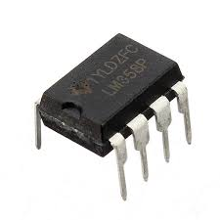
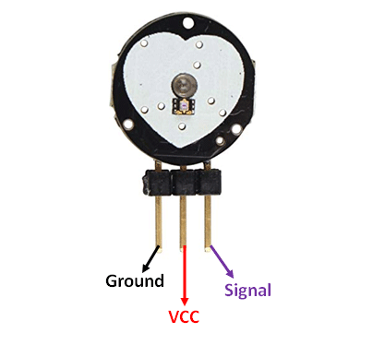

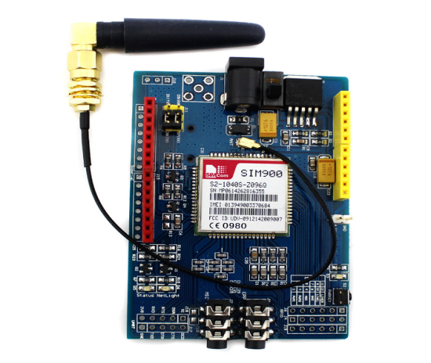
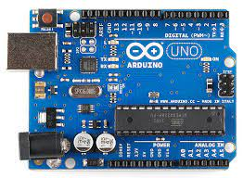

BLOCK DIAGRAM
HEART
SENSOR
OP-AMP
ARDUINO
POWER SUPPLY
GSM
RELATIVE
MOBILE

Slide 6
COMMUNICATION BETWEEN ARDUINO AND GSM:
The Tx and Rx pin of Arduino board are connected to Rx and Tx pins of GSM modem respectively
When patient put his finger on heart beat sensor then the sensor counts the heart beat according to pumping of heart and generates output in the form of pulses.
This count is given to Arduino pin no.

Slide 7
ARDUINO CODE
1.To change sms sending mode : AT+CMGF=1
myserial.println(“AT+CMGF=1”);
2.To read SMS in text mode : AT+CNMI=2,2,0,0,0
myserial.println(“AT+CNMI=2,2,0,0,0”);
3.To make a call : ATD+60XXXXXXXXXX;
//replace X with number you want to call,change +60 to your country code
myserial,.println(“ATD+60XXXXXXX;”);

Slide 8
ARDUINO CODE
4.To disconnect / hangup call : ATH
myserial.println(“ATH”);
5.To redial : ATDL
myserial.println(“ATD”);
6.To receive a phone call : ATA
myserial.println(“ATA”);

Slide 9
ADVANTAGES
Inexpensive alternative to smart watches and other expensive heart rate monitors
The device can be used by non-professional people at home.
The continuous monitoring allows doctors to patient any abnormal conditions in the heart
Machine learning and deep learning algorithms can be implemented for predicting the heart dieseases based on the recorded data

Slide 10


